Slide 1
Prediction Of No Shows For Patients
Data Scientist: Rayhaan Dustagheer
Date: 12th September 2024

Slide 2
Introduction
In the healthcare industry, missed appointments or no-shows can lead to significant inefficiencies, wasted resources, and lost revenue. For businesses like clinics and hospitals, accurately predicting which patients are likely to not show up for their scheduled appointments can help in optimizing scheduling processes, reducing idle time, and improving patient care.
This presentation explores the analysis of a no-shows dataset and showcases the predictive modeling techniques used to identify patterns and build a model that can forecast the likelihood of a patient not attending their appointment. By leveraging machine learning models, we aim to provide a data-driven solution that can support better appointment management and improve overall operational efficiency.

Slide 3
Objectives of the report
The primary objective of this analysis is to develop a machine learning model that can accurately predict patient no-shows based on historical appointment data. By doing so, we aim to:
Identify key factors contributing to missed appointments.
Enhance operational efficiency by minimizing the impact of no-shows.
Assist healthcare providers in making data-driven decisions to improve appointment scheduling and resource allocation.
Reduce patient no-show rates, thereby increasing service utilization and optimizing patient care delivery.

Slide 4

Dataset Overview - Part 1
The dataset is a csv format that has been obtained from Kaggle website and goes by the name of No-Show Appointment May 2016. It consists of 14 columns (features) and 110527 rows. The columns are as follows:

Slide 5
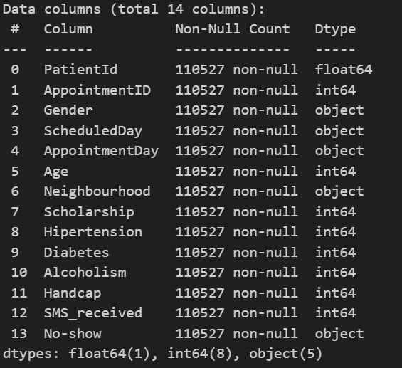
Dataset Overview - Part 2
The data types of the columns are mostly float64, int64 and object, showing a mixture of numerical and categorical variables.
There seems to be no null and missing values from the dataset.

Slide 6
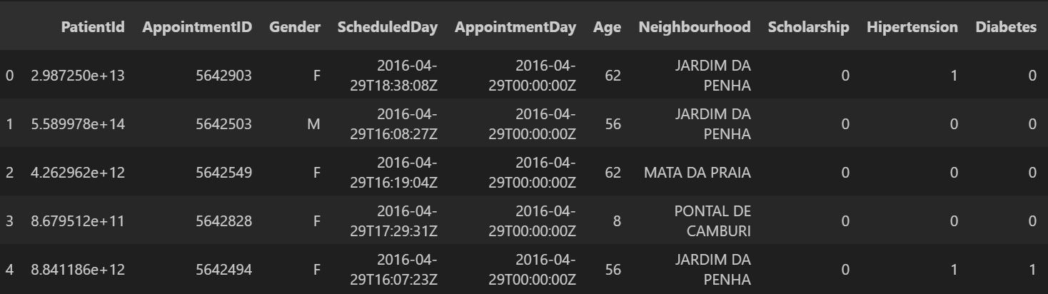
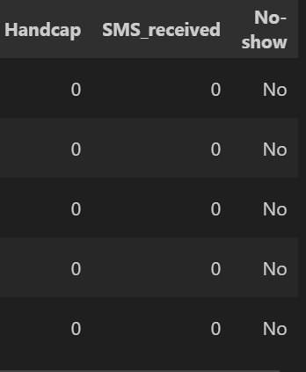
Dataset Overview-Part 3
Age, Patient Id and Appointment ID seems to be the numerical columns while the remaining columns are categorical columns. Scheduled Day and Appointment Day are dates. All the categorical variables are in 1s and 0s.
The picture below shows an explanation of the compositions of the different columns.

Slide 7
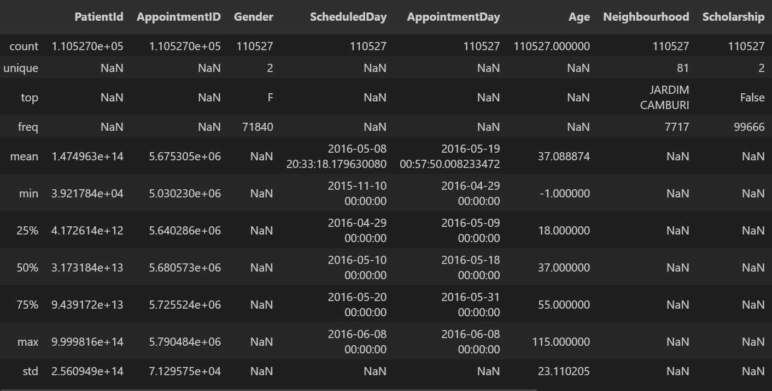
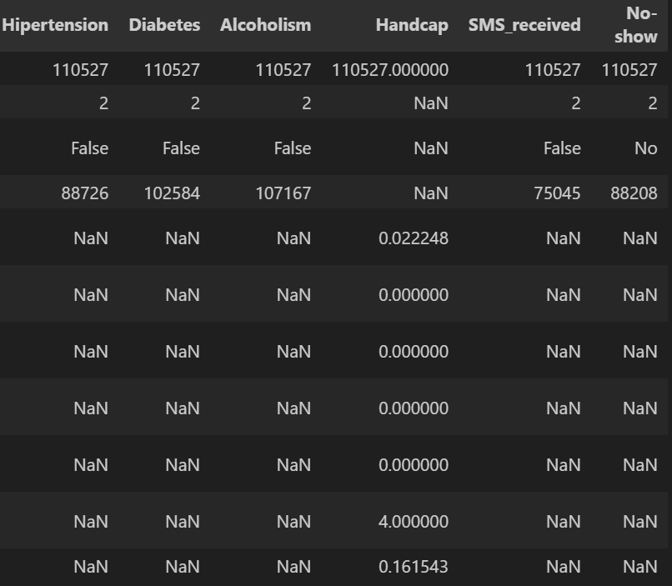
Dataset Overview -Part 4 (statistics)

Slide 8
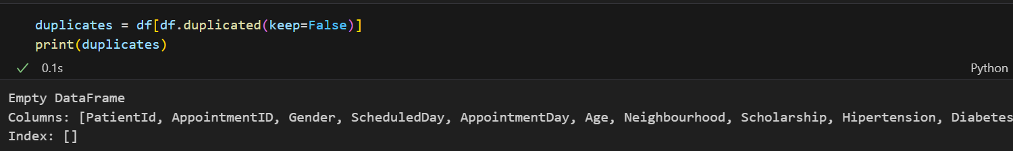
Dataset Overview -Part 4 (stats explained)
From the above diagram we can see that we have 2 unique genders, 81 unique neighborhoods, and 2 unique values for the columns of Scholarship, Hypertension, Alcoholism, Diabetes and No Show.
The most common neighborhood is Jardim Camburi
The min age is -1 which is erronated data that will be removed.
From the diagram below, there seems to be no duplicate data

Slide 9
Data wrangling and feature engineering
Age of -1 have been removed
There are no duplicates of data
A new feature of waiting days has been created (Appointment day - Scheduled Day)
The scheduled day has been dropped and the Appointment Day has been converted to name of the day of the week.
The numerical and categorical columns have been separated into 2 different dfs for analysis
The column of Appointment ID and Patient ID since they are not informative of No Shows.

Slide 10
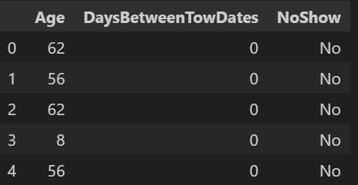
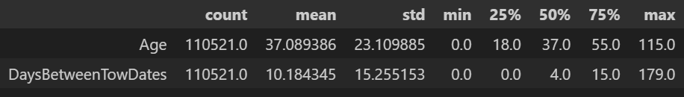
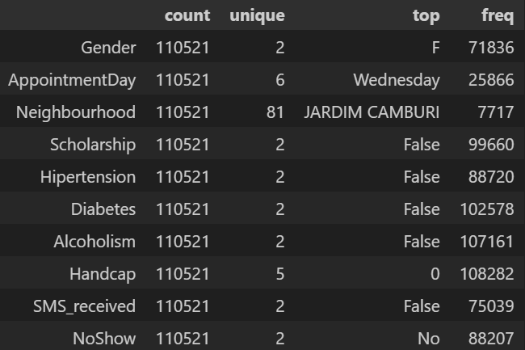
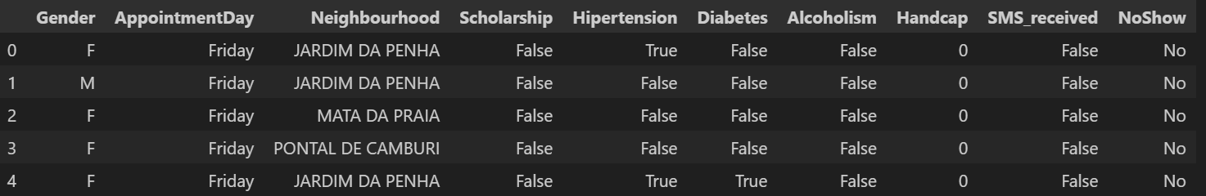
Data wrangling and feature engineering (diagrams)

Slide 11
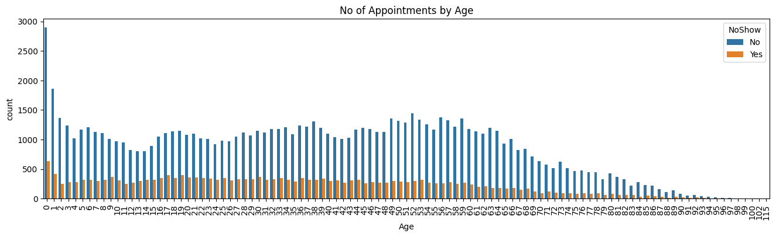
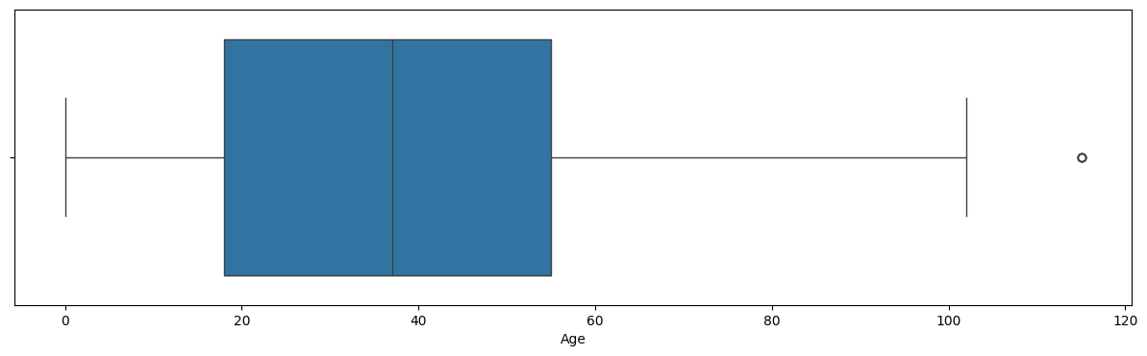
Analysis of numerical variables -Age

Slide 12
Analysis of Numerical Variables (Explanations -Age)
From the Countplot, we see that the highest rate of no show is of age 0 years and the least rate of no show is of age between 80 to 115 years old
For all the other age groups, the number of No Shows is almost the same.
From the box and whisker plot, we see that the age has an interquartile range 18-55 years old.
The min value is 0 while the max value is 115 which is an outlier.
The distribution of age is slightly skewed to the left.

Slide 13
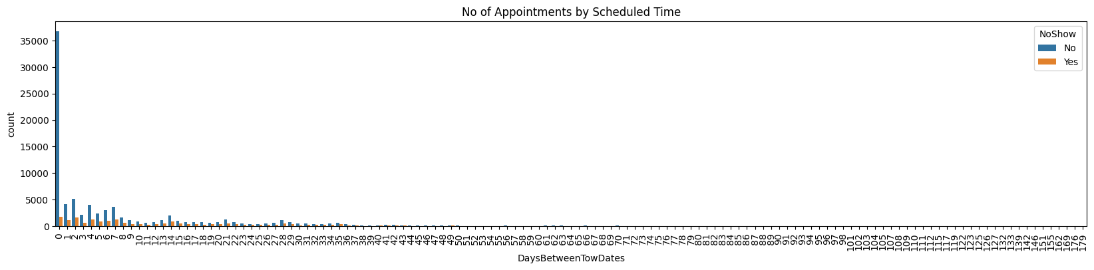
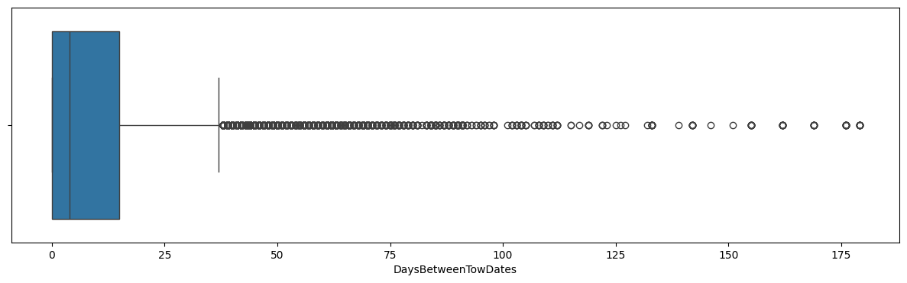
Analysis of Waiting days variable

Slide 14
Analysis of waiting days - Explanation
It can be seen from the count plot that the highest number of waiting days is zero and for that the ratio of shows and no shows is very high in favour of shows.
From the box and whisker plot we can infer that the data is highly positively skewed and that the interquartile range lies between 0 to 12 days with numerous outliers present.
The max value is 179 days, the min value is 0 days and the median is around 4 days.

Slide 15
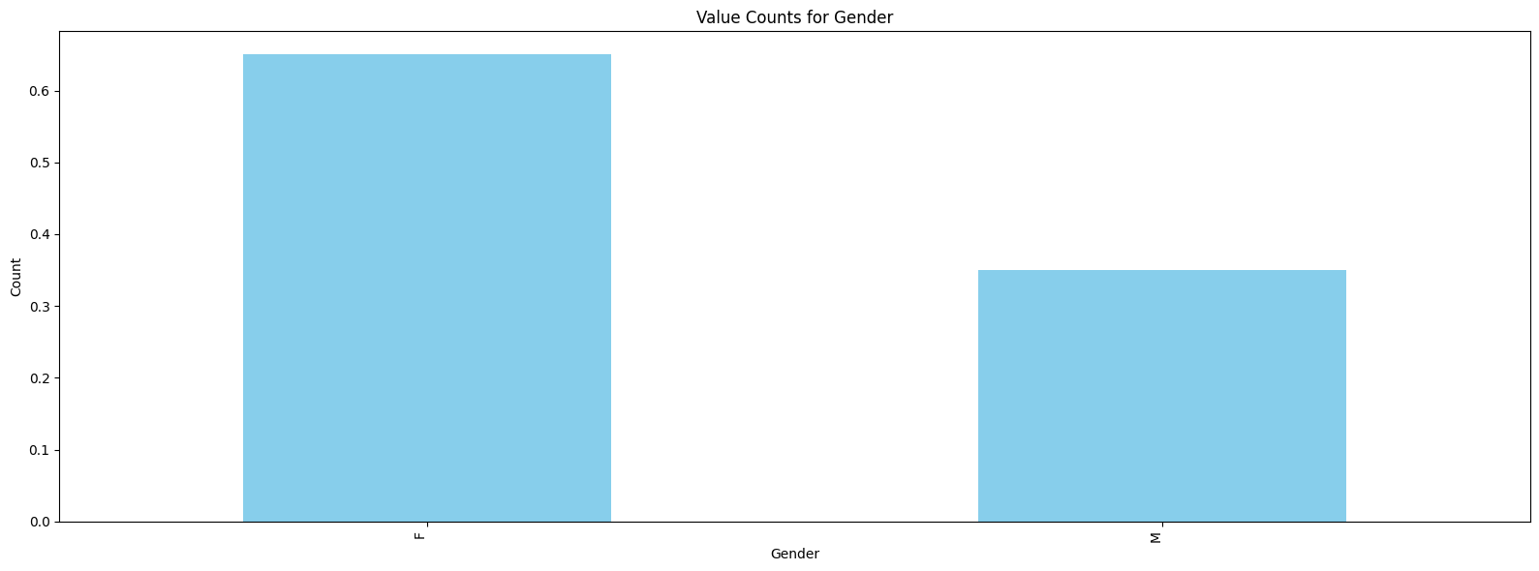
Univariate analysis of gender
We see that the population of patients is 65% females while males make up to 35%.

Slide 16
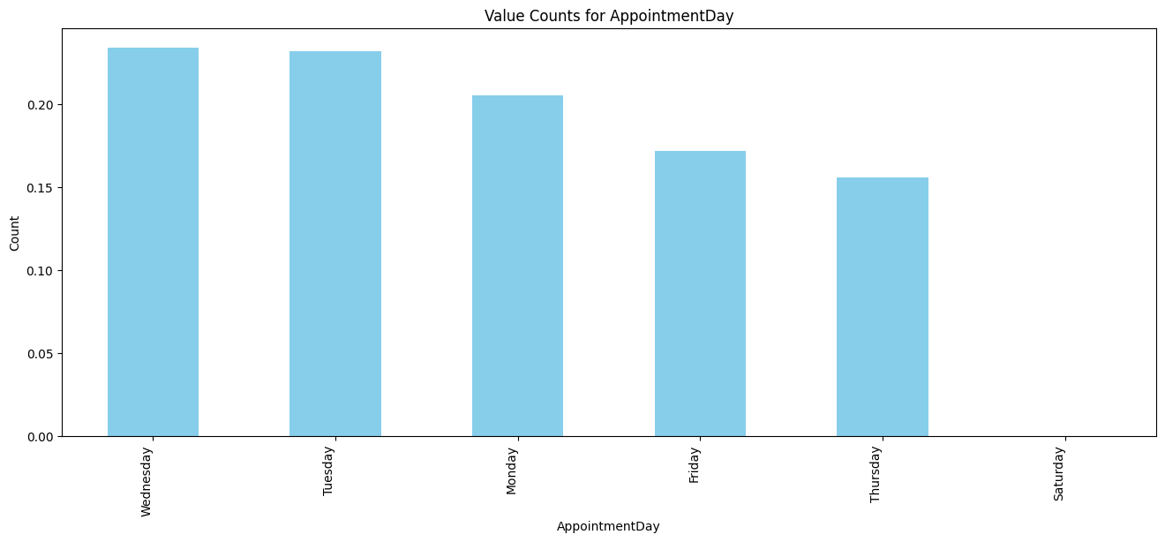
Univariate analysis of Appointment Days
Wednesdays and Thursdays are the most common and preferred days for appointments making up to 25 percent of the appointments each.
The day with the least appointment would be a Saturdy

Slide 17
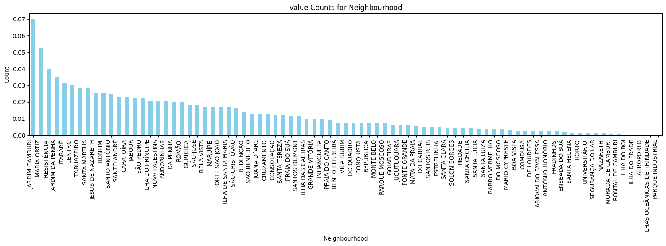
Univariate analysis of Neighbourhood
The greatest number of appointments is from the neighborhood Jardim Camburi accounting for 70 % of the number of appointments and the smallest number is from the region Parque Industrial

Slide 18
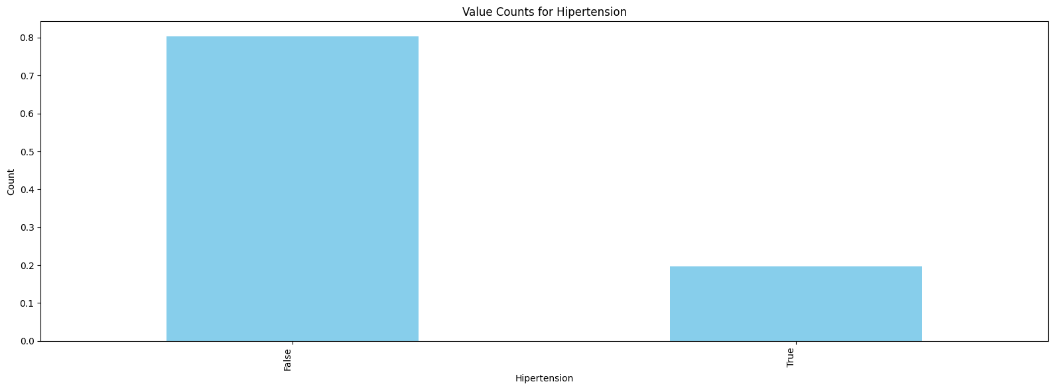
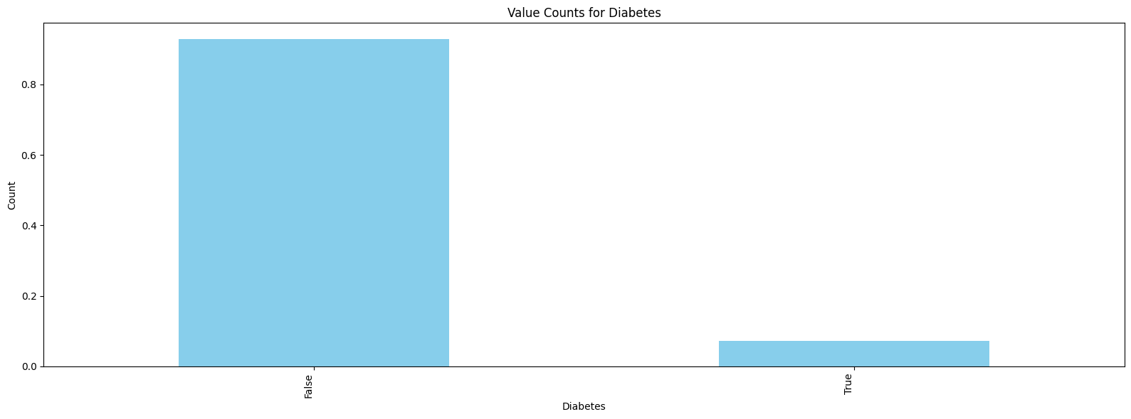
Univariate analysis of diseases

Slide 19
Univariate Analysis of diseases (Explanation)
People with diabetes account for 80 % of the appointment population
People with Hypertension account for 80% of the appointment population as well
We can conclude that most people suffer from either diabetes or Hypertension or both.

Slide 20
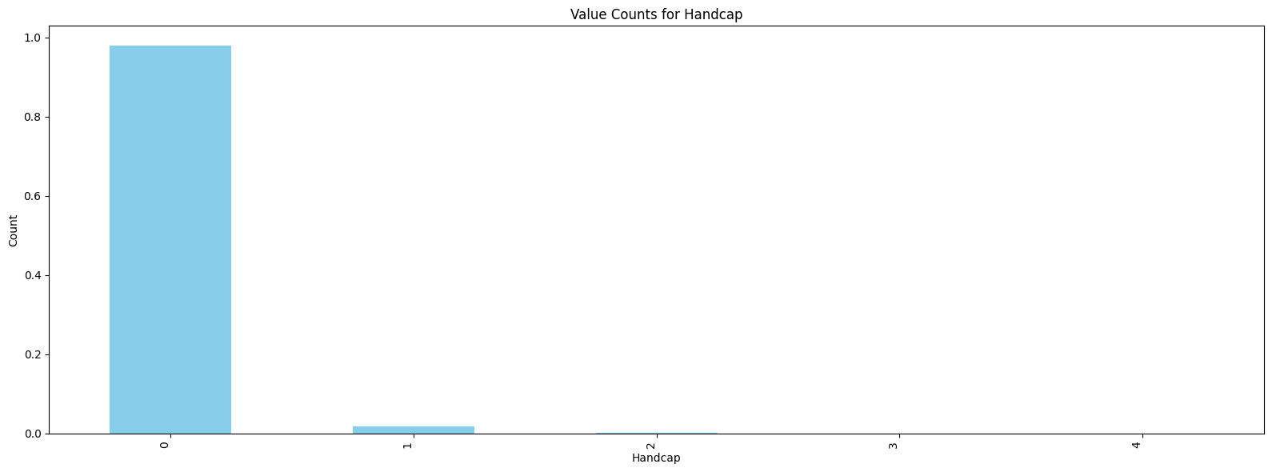
Univariate analysis of Handicap
We see that most people who suffer from handicap suffer from type 0 handicap which makes us to 90 percent of the handicapped population

Slide 21
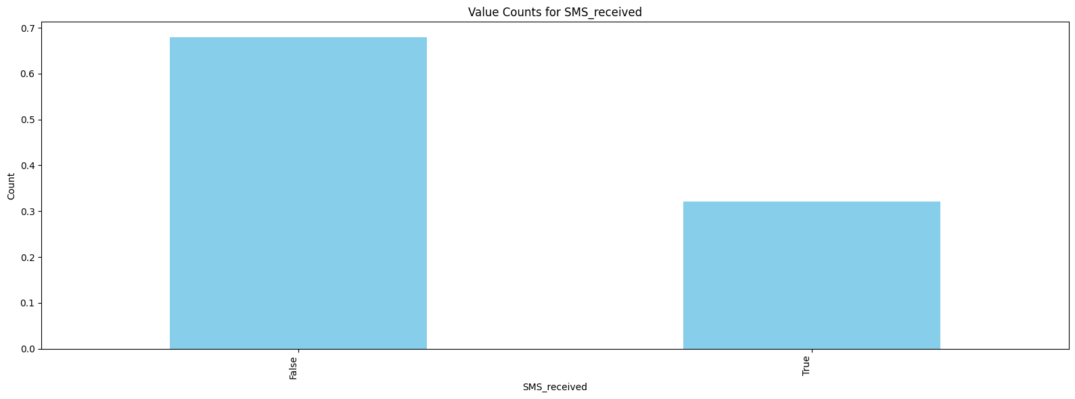
Univariate analysis of SMS received
We see that a lot of the population did not receive SMS, making up to 65 % while 35% of the people received an SMS

Slide 22
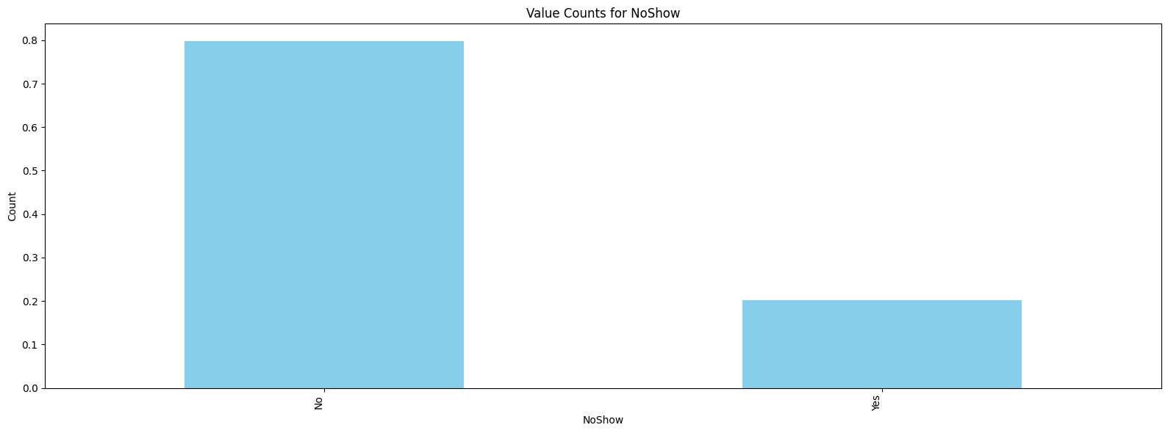
Univariate analysis of no shows
80 percent of people did not show up for the appointment

Slide 23
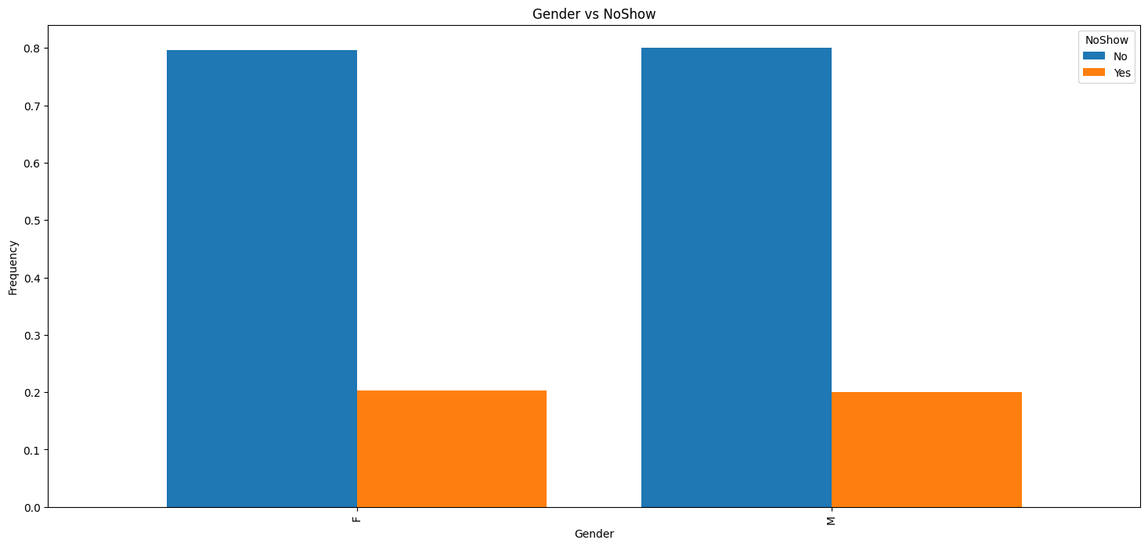
Bivariate analysis of Gender and no shows
Both male and females have an equal ratio of shows to no shows

Slide 24
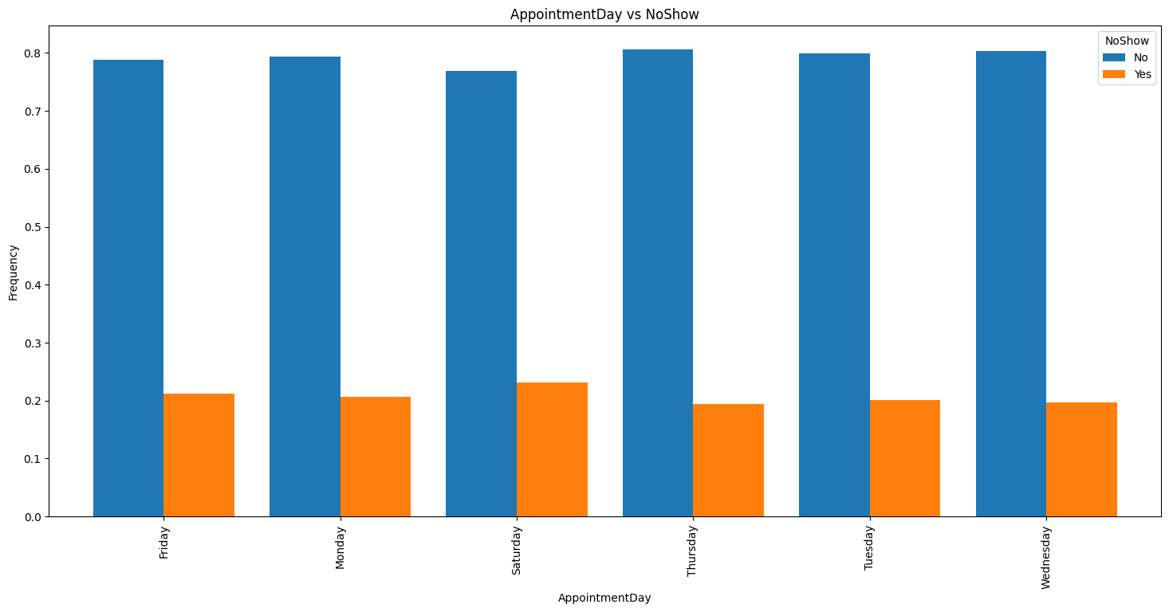
Bivariate analysis of appointment days
All the days have an almost equal rate of no shows

Slide 25
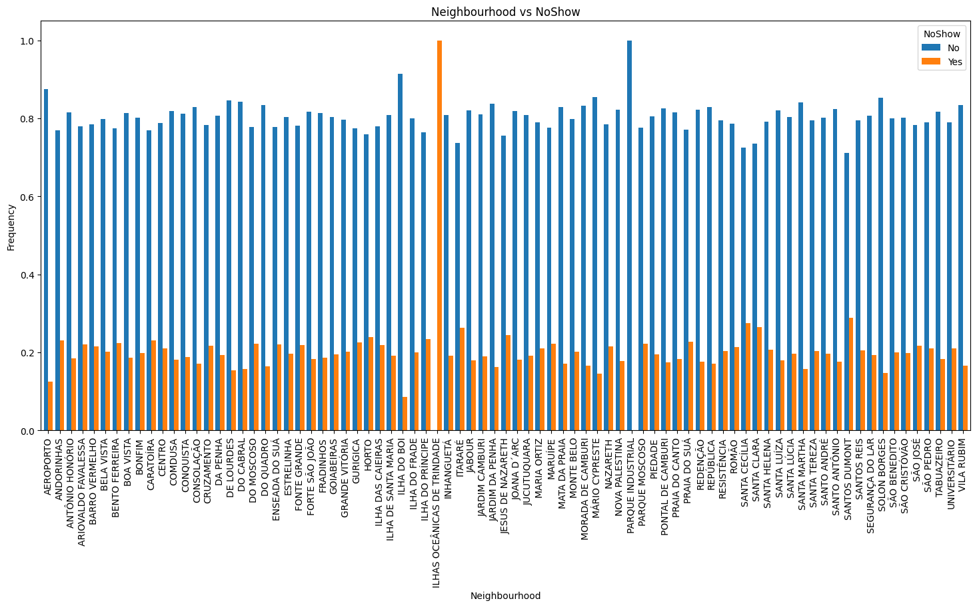
Bivariate analysis of Neighbourhood
It can be seen that the highest number of no shows is from the neighborhood ilhas oceanicas de Trindade
The greatest number of shows is from the neighbourhood Parque Industrial.
The remaining neighbourhood have a more or less similar ratio of shows to no shows

Slide 26
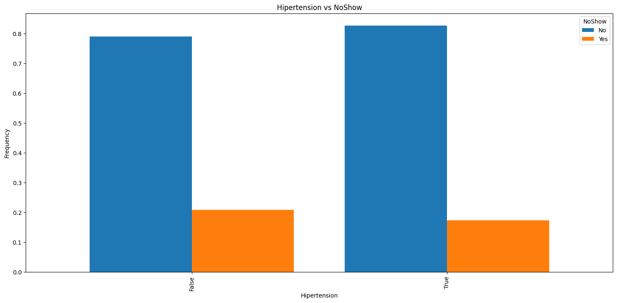
Bivariate analysis of Hypertension and no shows
People with no Hypertension have a slightly higher ratio of no shows to shows as compared to people with hypertension

Slide 27
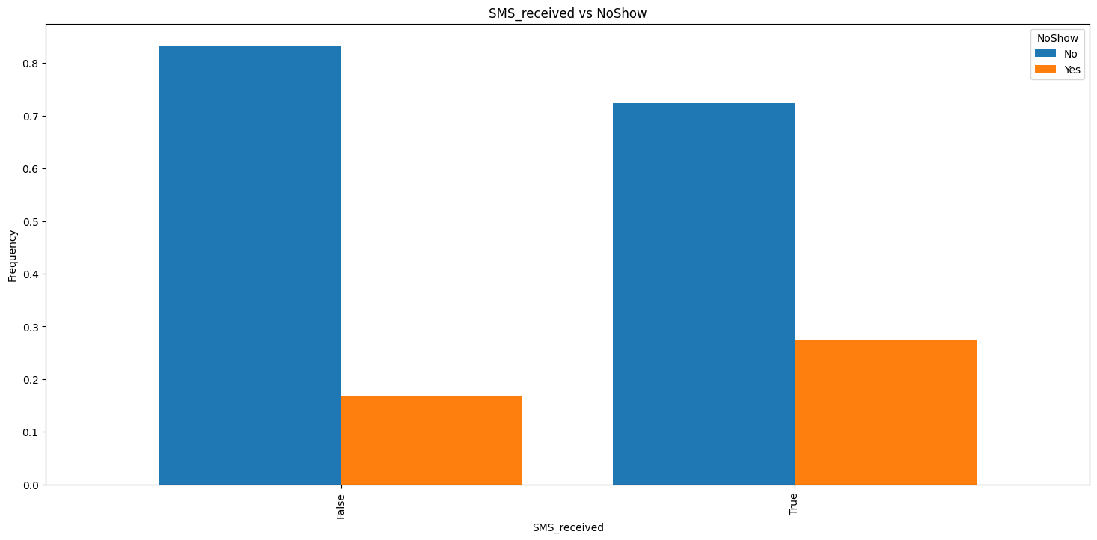
Bivariate analysis of SMS received and no show
Surprisingly the ratio of shows to no show is higher for people who received SMS than people who did not.

Slide 28
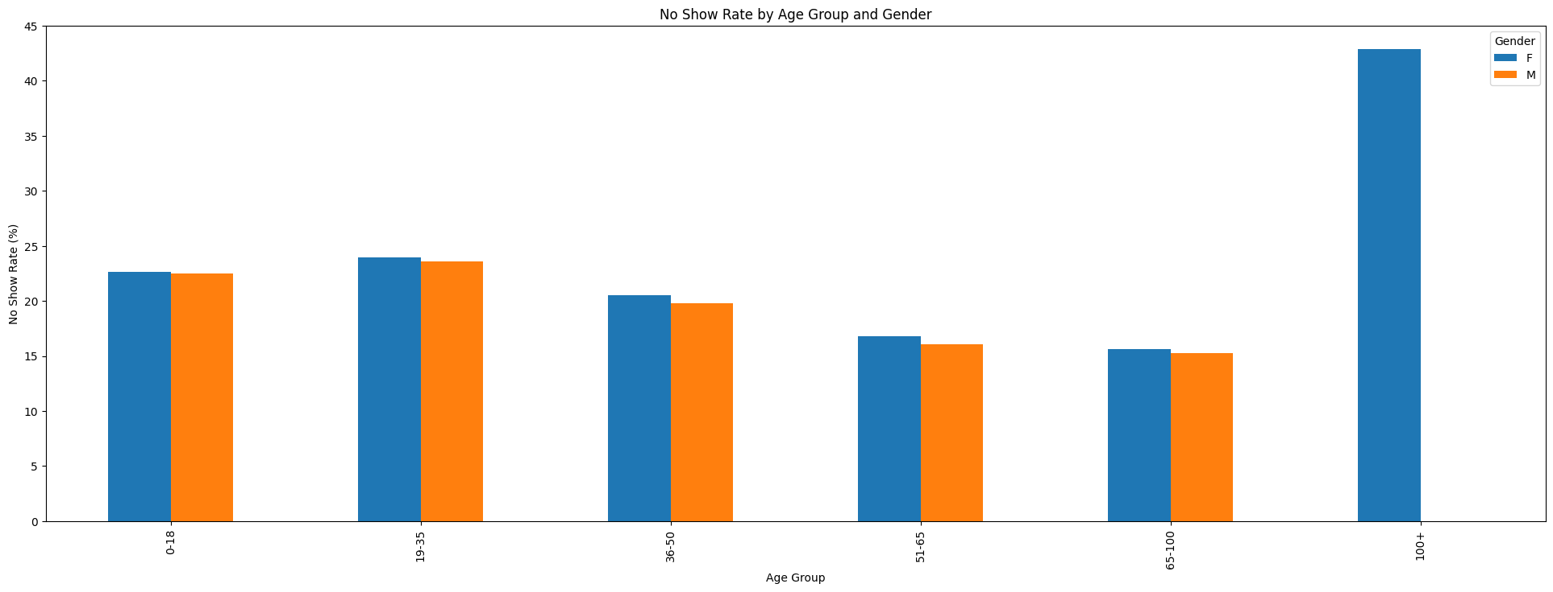
Multivariate analysis: Age, gender and no shows.
Old female patients have a much higher percentage of no shows and the greatest percentage of female patients that have no shows is for the age group of 100+

Slide 29
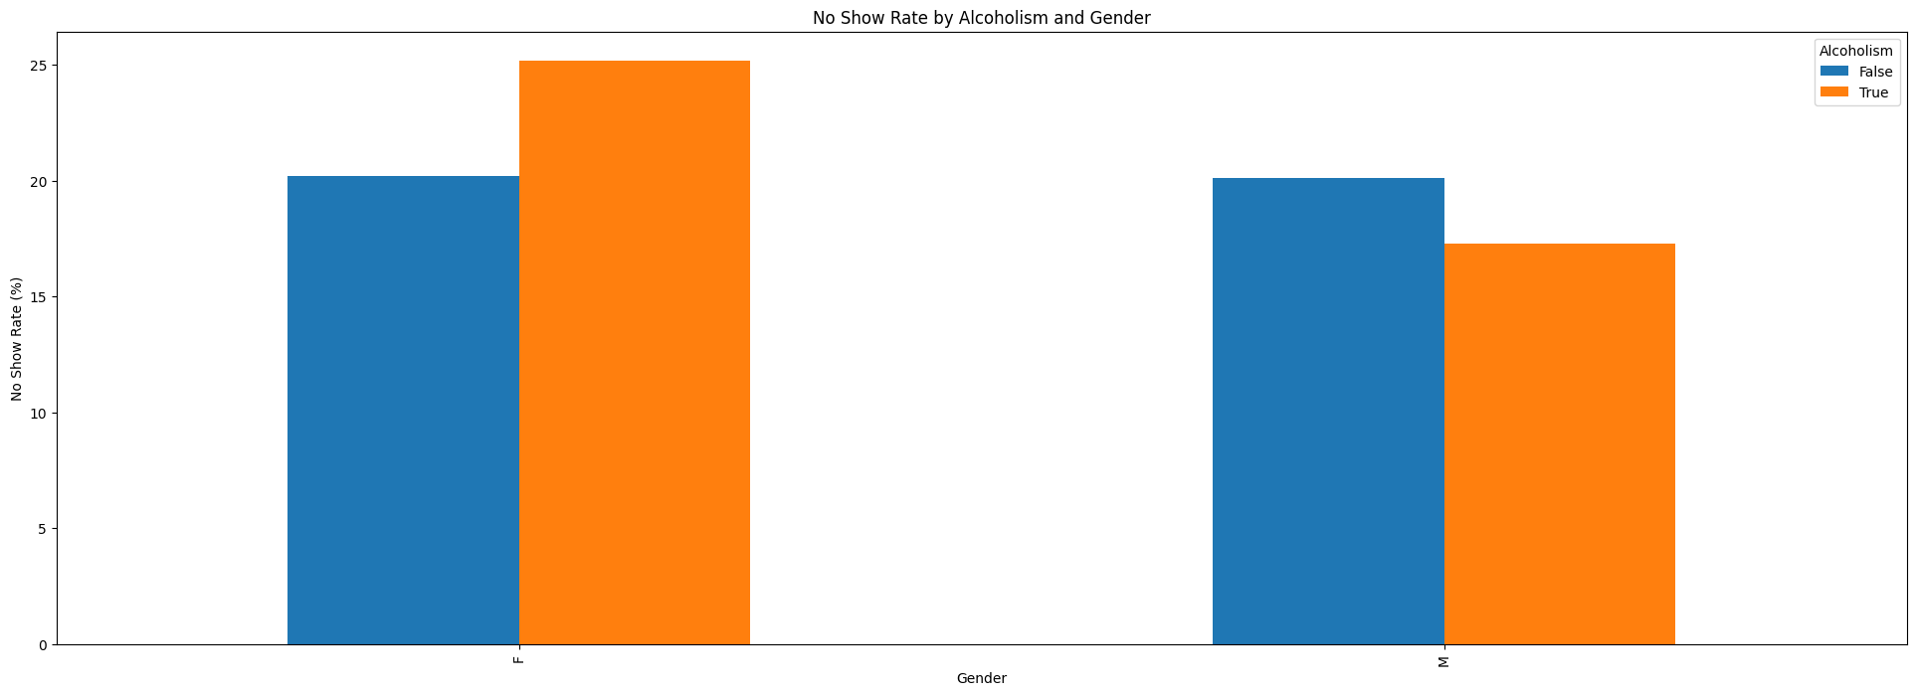
Multivariate analysis alcoholism, gender and no shows
Female patients have a higher rate of alcoholism and no shows

Slide 30
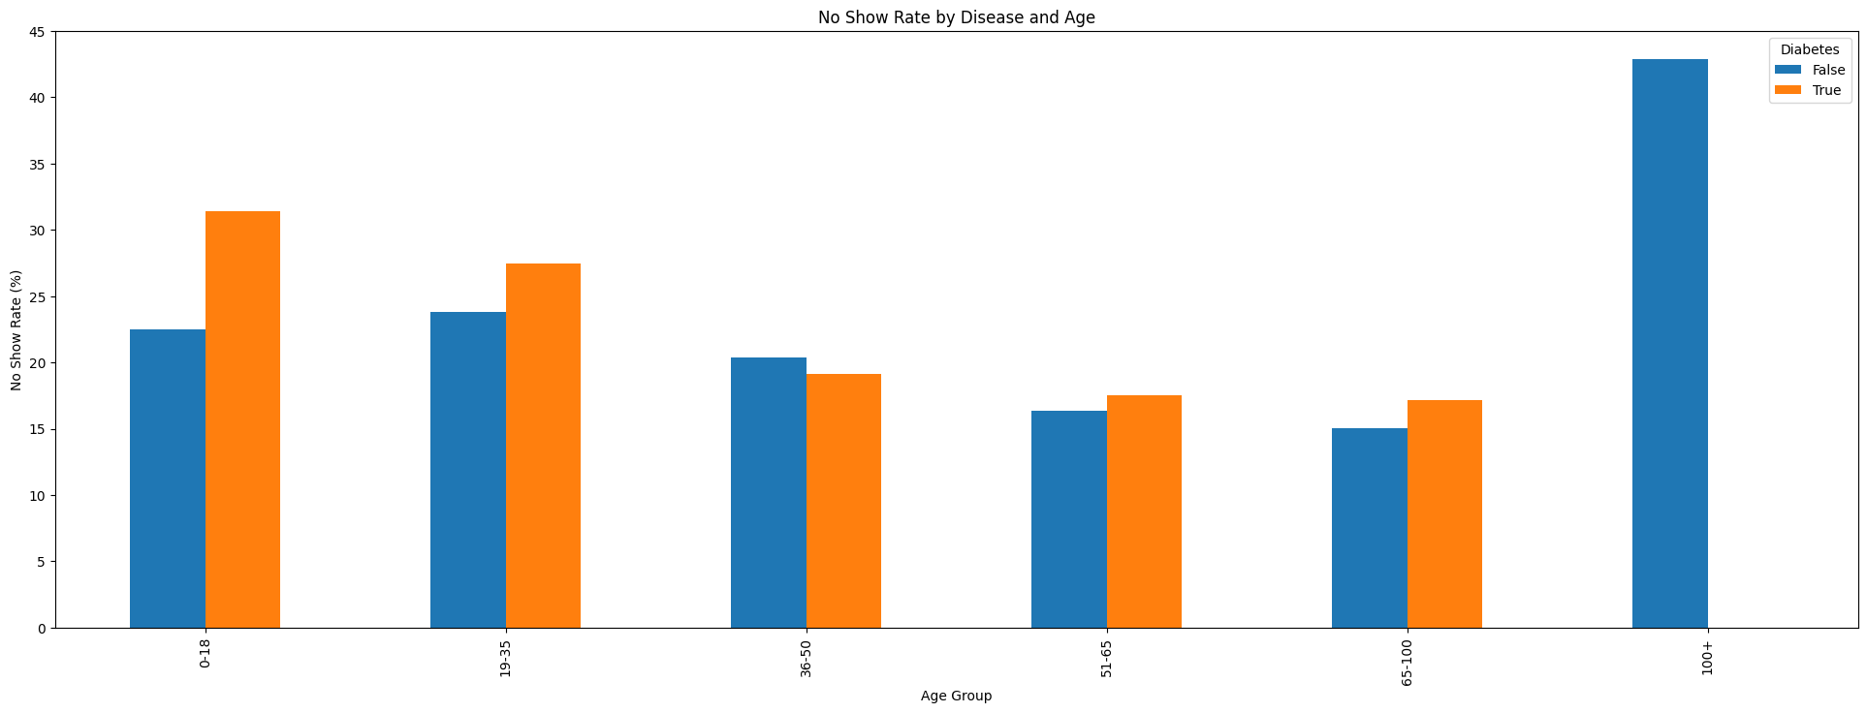
Multivariate analysis of Diabetes, Age and no shows
People in the age group of 0-18 have a higher percentage of diabetes and the no show percentage rate is 30 %

Slide 31
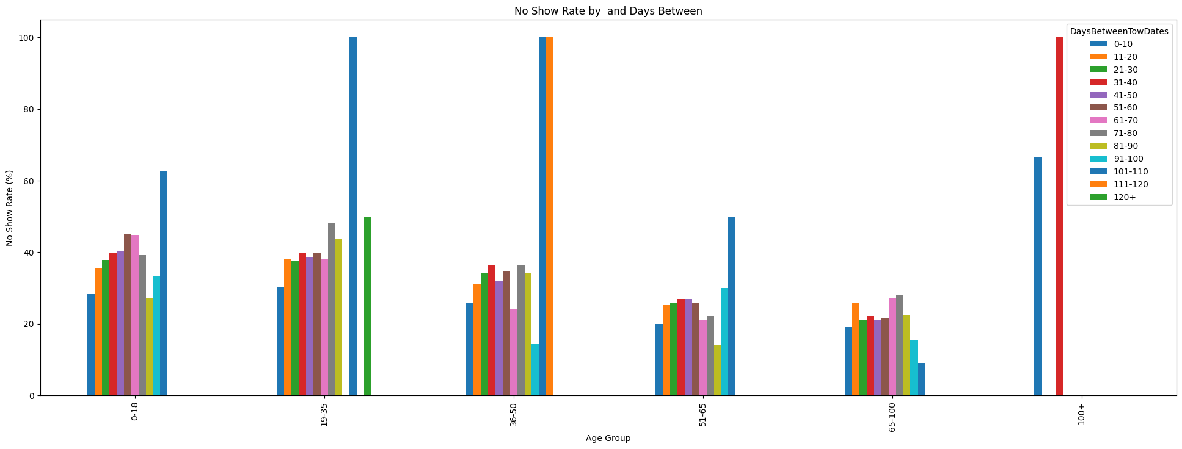
Multivariate analysis of age group, sms received and no shows
People from the age group of 36-50 years have had the highest rate of no shows with a waiting period of 0 to 20 days

Slide 32
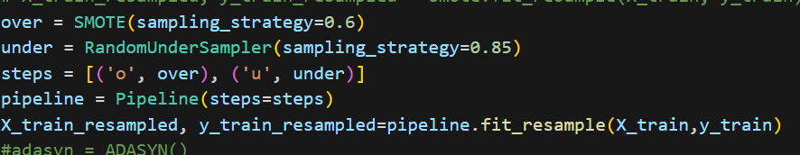
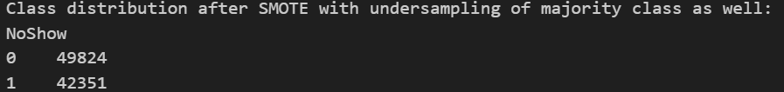
Class imbalance
Since the dataset consists of 80 % of no shows and 20 percent of shows, we have an imbalanced dataset.
This has been tackled by undersampling randomly the majority class and oversampling the minority class using the SMOTE technique with sampling strategy of 60% of the majority class.

Slide 33
Model building, prediction and evaluation
For the prediction of No shows, 3 models have been built and trained on the dataset to give the probability of no shows.
A logistic regression model and 2 ensemble models, namely a Random Forest Classifier and an XGBoost classifier have been used
The models have been trained on a dataset that is fit for model building where categorical variables have been encoded
The evaluation metrics have been recorded and the ROC-AUC curve has been selected to evaluate the performance of the model

Slide 34
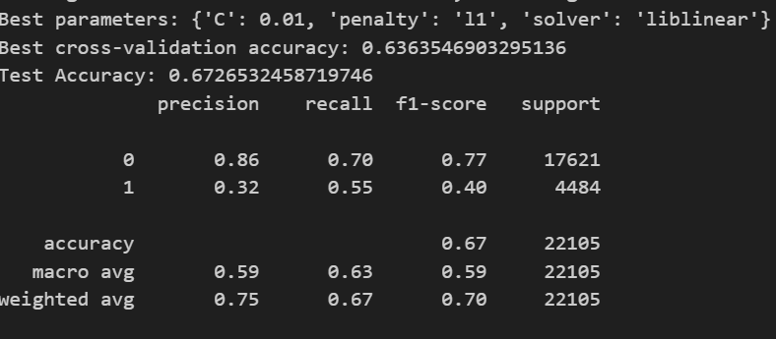
Logistic regression evaluation metrics
We see that the precision for class 0 is 0.77 and that of the class 1 is 0.40.
The recall is a bit better with 0.70 for class 0 and 0.55 for class of no shows
SInce we balanced the dataset, the test accuracy is 67.3%, which is more than the train accuracy showing that no overfit.

Slide 35
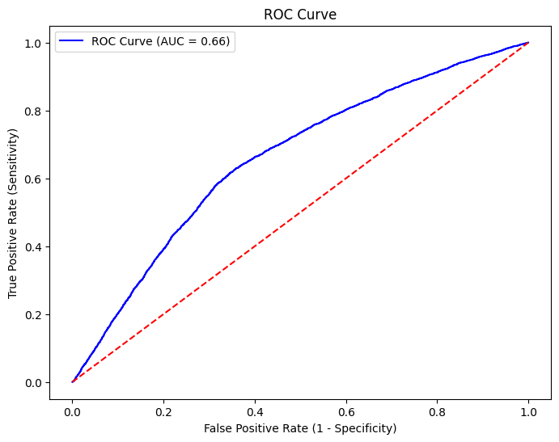
Logistic regression ROC-AUC curve
The performance of the curve is slightly better than the random classifier

Slide 36
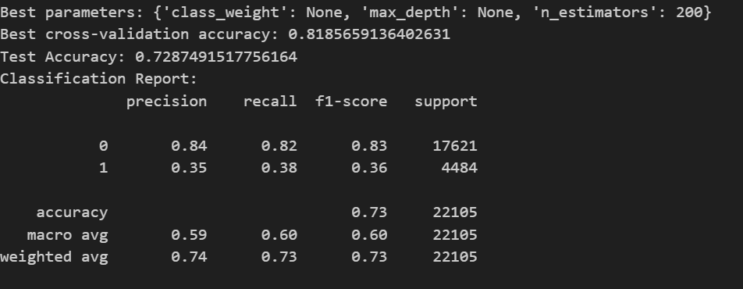
Random forest classifier
The test accuracy is 73 % while the recall and precision are around 35 % for the class of no shows

Slide 37
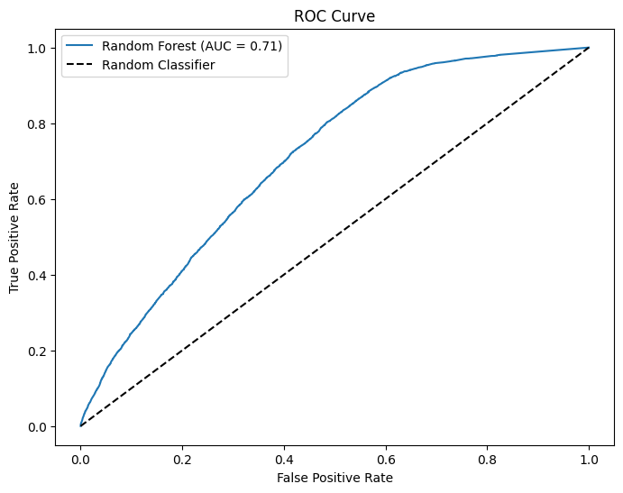
Random forest classifier ROC-AUC curve
The ROC-AUC curve is 71 % and hence it is way better than a random classifier

Slide 38
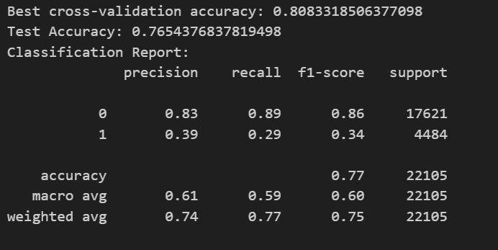
XGBoost Classifier
The precision for the XGBoost classifier for class of shows is 0.83 while that of no shows is 0.39
The recall is 0.89 for shows and 0.39 for no shows

Slide 39
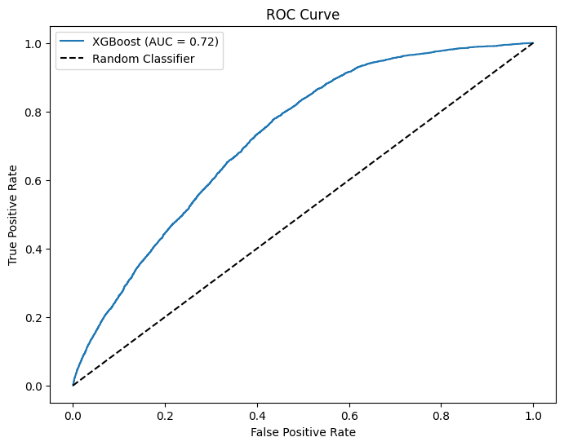
XGBoost Classifier: ROC AUC curve
The ROC curve is 0.72, which is better at differentiating the classes than a random classifier

Slide 40
Conclusion
After the analysis of the dataset, it can be seen that not much of the features explain the outcome of shows and no shows.
Among the 3 classifiers, the XGBoost is better at prediction and provides probabilities of prediction as well
A better dataset with more features or more features engineering would provide better prediction outcomes and probabilities

